Slide 1
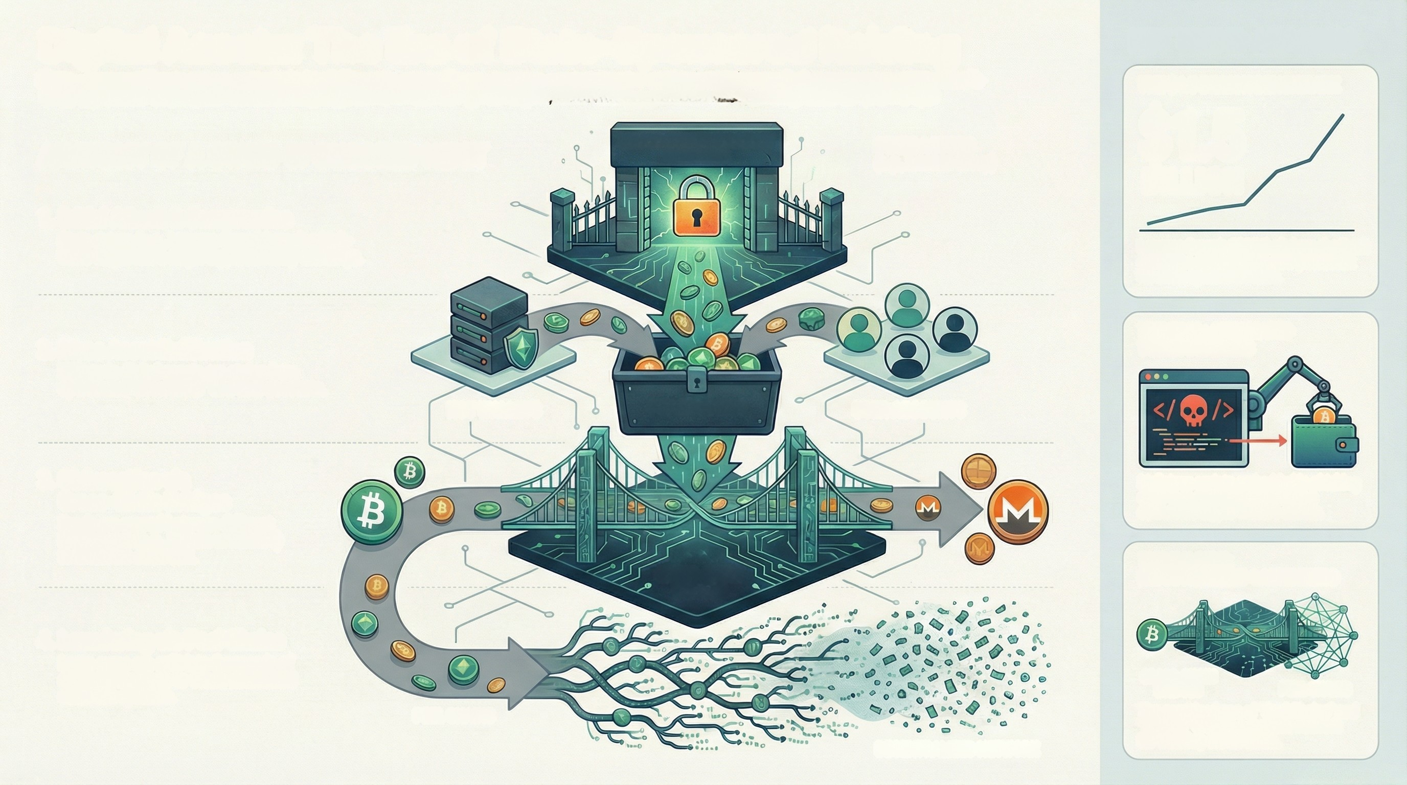
Digital Assets: The Era of State-Sponsored Raiding
State-sponsored threat actors, particularly North Korea's Lazarus Group, are now conducting industrialized digital asset theft on an unprecedented scale.
These operations utilize automated tools and cophisticated laundering techniques, transforming cybercrime into a primary driver of national GDP.
KEY TREND ANALYSIS
THE $1.5 BILLION BENCHMARK
$1.5
BILLION
ANATOMY OF A STATE-SPONSORED HEIST
MAJOR CRYPTOCURRENCY
EXCHANGE
STATE ACTORS
(e.g., Lazarus Group)
1. Initial Attack & Compromise
State actors (e.g., Lazarus Group) breach a high-
value farget like a major cryptocurrency exchange.
Lazarus Group's 2025 theft from the Bybit
exchange established a new precedent
for state-aponaored raids.
2. Mass Asset Exfiltration
Billions in digital assets are stolen from
operational "hot wallets" and user accounts.
THE TOOL: AUTOMATED
TOKEN DRAINERS
HOT WALLETS
STOLEN ASSETS
USER ACCOUNTS
3. Obfuscation via
Cross-Chain Bridges
Funds are moved between different
blockchains (e.g., Bitcoin to Monero)
to break the audit trail.
Malicious scripts embedded in phishing
sites that automatically empty a
connected crypto wallet's assets.
THE EVASION:
CROSS-CHAIN
BRIDGES
INDUSTRIALIZED LAUNDERING
4. Laundering via Peel Chains
Large sums are spilt into thousands of
small transactions to evade automated
detection systems.
0-10
CROSS-CHAIN
BRIDGES
PEEL CHAINS
PEEL CHAINS
The combined use of "Peel Chains" and
"Bridges" creates a resilient network
for washing stolen funds.
DECENTRALIZED NETWORK

